Slide 1
Competitive Advantage – Porters Five Forces
Computer Systems Management
Module Code CT012-3-3
Level 3
VD1

Slide 2
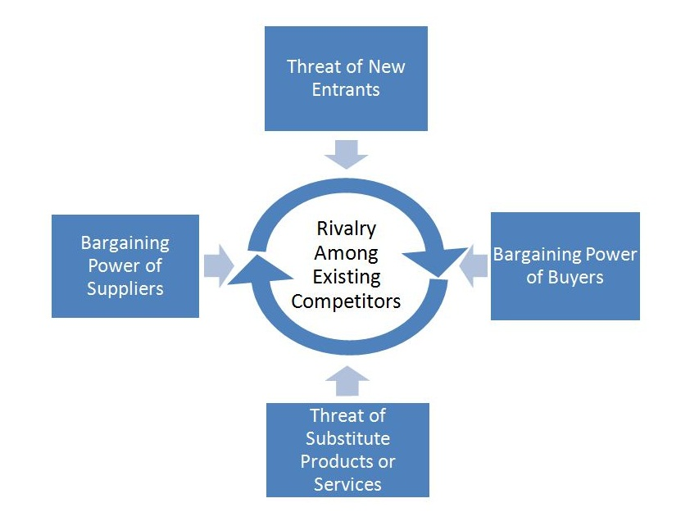
Learning Outcomes
Porter’s Five Forces
Threat of New Entrants
Bargaining Power of Suppliers
Bargaining Power of Buyers
Threat of substitute products
or services
5. Rivalry amongst existing
competitors

Slide 3
Content
Porter’s Five Forces
Economies of Scale

Slide 4
Key Terms
Porter’s Five Forces
Threat of New Entrants
Bargaining Power of Suppliers, Bargaining Power of Buyers, Threat of substitute products, Rivalry

Slide 5
Porter’s Five Forces
Michael Porter’s competitive forces model
  Provides general view of firm, its competitors and environment
  Five competitive forces shape fate of firm:
    Traditional competitors
    New market entrants
    Substitute products and services
    Customers
    Suppliers

Slide 6
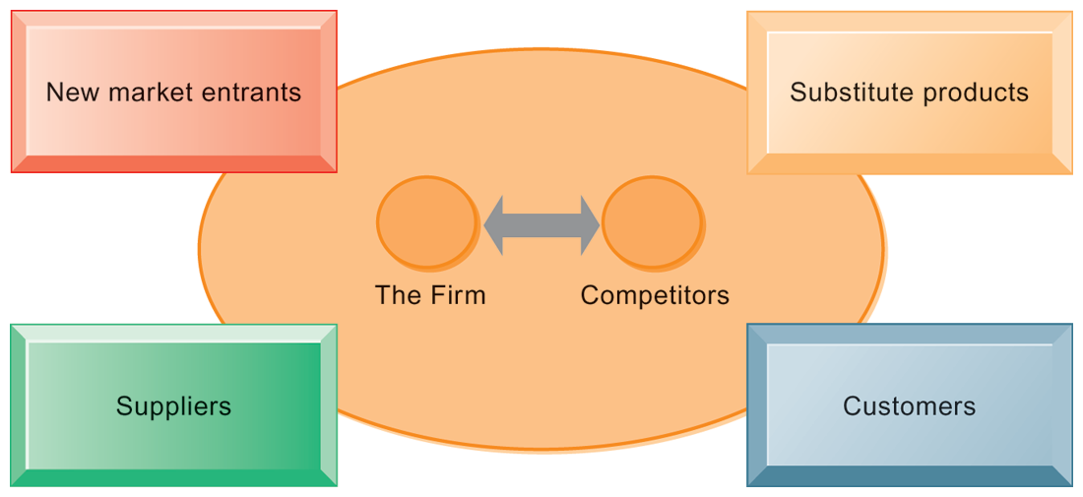
Porter’s Five Forces
PORTER’S COMPETITIVE FORCES MODEL
In Porter’s competitive forces model, the strategic position of the firm and its strategies are determined not only by competition with its traditional direct competitors but also by four other forces in the industry’s environment: new market entrants, substitute products, customers, and suppliers.

Slide 7
Industry Competitors
Strongest of the five forces. Varies
widely among industries
  If competition is weak, companies may be able to raise prices, provide less product for the price and earn more profits
  If competition is intense, it may be necessary to enhance product offerings to keep customers and prices may fall below break-even levels (point where cost = income, there is neither profit nor loss)
Notes:
High rivalry means firms compete vigorously—and compete away above average profits.
Industry conditions that favor rivalry
Large number of competitors
Slow or declining growth
High fixed costs/and or high storage costs
Low product differentiation
Industry capacity can only be added in large increments

Slide 8
Industry Competitors
Opportunity – Weak rivalry
Few competitors 2. Industry sales growing
Significant differentiation
Minimal exit barriers – obstacles preventing a firm to leave the industry (highly specialized equipment) or cost or losses incurred as a result of ceasing operations
Threat – Intense rivalry
Numerous competitors 2. Industry sales slowing
3. No differentiation 4. High exit barriers
5. Big firms acquire weak firms
6. Industry conditions tempt competitors to use price cuts or other competitive weapons
Notes:
Rivals are competitors within an industry. Rivalry in the industry can be weak, with few competitors that don’t compete very aggressively. Or it can be intense, with many competitors fighting in a cut-throat environment.
Factors affecting the intensity of rivalry are:
• Number of firms – more firms will lead to increased competition.
• Fixed costs – with high fixed costs as a percentage of total cost, companies must sell more products to cover those costs, increasing market competition.
• Product differentiation – Products that are relatively the same will compete based on price. Brand identification can reduce rivalry.

Slide 9
Threat of New Entrants
Possibility of new firms entering the industry
Bring a desire to gain market share and often have significant resources.
May force prices down and put pressure on profits
Barriers to entry protect the companies already in business
  costs and/or legal requirements needed to enter a market
  unique for each industry and situation, and can change over time

Slide 10
Threat of New Entrants
Opportunity – Difficult to enter
Strong product differentiation
Significant switching costs
3. Brand Preferences
4. Capital requirements
  - investment, advertising, promotion
5. Controlled access to distribution channels
6. Patent or proprietary know how
  firms enjoy protection from new entrants.
7. Significant switching costs

Slide 11
Threat of New Entrants
Threat – Easy to enter
None or low economies of scale
Weak product differentiation
Customers have little brand loyalty
Minimal switching cost – new firms can enter the industry and lure the customers away from their previous suppliers
Start-up costs are low
Open access to distribution channels
Common technology

Slide 12
Economies of Scale
  Economies of Scale
  Reduction in per unit cost of production when production volume increases e.g.
Example
  Fixed cost of $1000 needed to produce 10 units of Pencil A
  Therefore, Cost = $100 per pencil
  To produce 50 units of Pencil A, Cost = $20
Management in businesses and organizations is the function that coordinates the efforts of people to accomplish goals and objectives by using available resources efficiently and effectively

Slide 13
Bargaining Power of Buyers
Power of buyers describe the effect that customers have on profitability
Transaction between seller and buyer creates value for both parties
  If buyers have more economic power, the ability to capture a high proportion of the value created will decrease, earning lower profits

Slide 14
Bargaining Power of Buyers
Opportunity – Weak buyers
  Buyer purchases small volumes
  Purchases highly differentiated and unique
  Buyer cannot manufacture products
  Buyer has limited information
Threat – Powerful buyers
  Buyer purchases large volumes
  Purchases standard or undifferentiated
  Buyer can manufacture product (retailer buys over manufacturer)
  Buyer has full information
Notes:
Powerful buyers can “squeeze” (lower profits) the focal firm by demanding lower prices and/or higher levels of quality and service.
Industry conditions that facilitate buyer power:
Small number of buyers for focal firm’s output
Lack of a differentiated product
The product is significant to the buyer
Buyers operate in a competitive market—they are not earning above normal profits
Buyers can vertically integrate backward
Many small buyers can be united around an issue to act as a block

Slide 15
Bargaining Power of Suppliers
All business need input — labour, services
raw material
Cost of input has significant effect on profits
Suppliers would prefer to sell at the highest price or provide no more services than necessary
  Weak supplier – strong position and able to negotiate favorable business deal
  Strong supplier - weak position and may have to pay a higher price or accept a lower level of quality or service
Notes:
Whether the strength of suppliers represents a weak or a strong force hinges on the amount of bargaining power they can exert and, ultimately, on how they can influence the terms and conditions of transactions in their favor.

Slide 16
Bargaining Power of Suppliers
Opportunity – Weak suppliers
  Supplying industry is fragmented
  Supplier’s products have substitutes
  Supplier’s products are not differentiated
  Minimal switching costs in supplier’s products
Threat – Strong suppliers
  Supplying industry has a few companies
  Supplier products do not have substitutes
  Supplier’s products are differentiated
  Significant switching costs
Notes:
Powerful suppliers can “squeeze” (lower profits) of the focal firm.
Industry conditions that facilitate supplier power:
Small number of firms in supplier’s industry
Highly differentiated product
Lack of close substitutes for suppliers’ product
Supplier could integrate forward
Focal firm is an insignificant customer of supplier

Slide 17
Substitute Products
Products from one business can be replaced by products from another
If your product is undifferentiated, customers can easily switch from your product to a competitor’s product with few consequences
  Example: Aluminum beverage cans against glass bottles and plastic containers. Coke and Pepsi are rivals, milk is a substitute for both
Substitutes place a price ceiling on products
  more difficult to raise prices and make greater profits if there are close substitutes and switching costs are low

Slide 18
Substitute Products
Opportunity - there are no good substitutes
Examples of Substitutes
Eyeglasses vs. Contact Lenses
Sugar vs. Artificial Sweeteners
Newspapers vs. TV vs. Internet
E-mail vs. Overnight Delivery
Threat - there are good substitutes
Product does not offer real benefit compared to other products
Easy for customers to switch
Customers have little loyalty
Notes:
Substitutes fill the same need but in different ways. Substitutes creates a price ceiling because consumers switch to the substitute if price the price gets too high. Substitutes will likely come from outside the industry—be sure to look

Slide 19
Summary
Question and Answer Session
Porter’s Five Forces - Threat of New Entrants, Bargaining Power of Suppliers, Bargaining Power of Buyers, Threat of substitute products or services and
Rivalry amongst existing competitors
2. Economies of Scale - reduction in per unit cost of production when production volume increases

Slide 20
Review Questions
Question and Answer Session
Name Porter’s Five Forces
Explain Economies of Scale

Slide 21

Question and Answer Session
Question and Answer Session
Q & A

Slide 22
What We will Cover Next
Porter’s Competitive Forces

